Slide 1

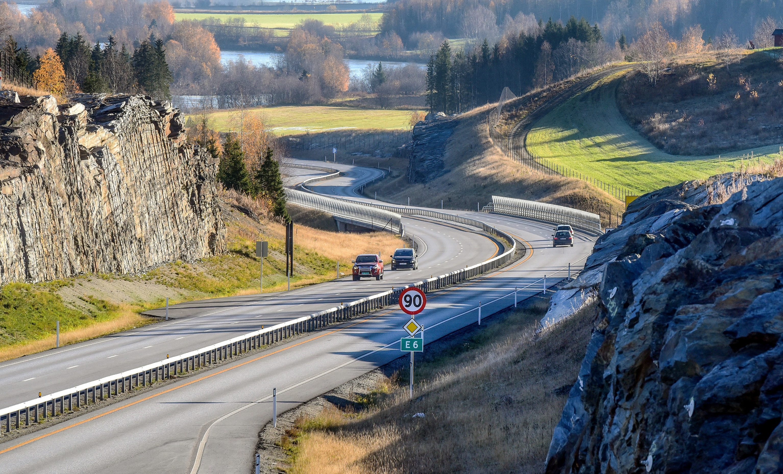

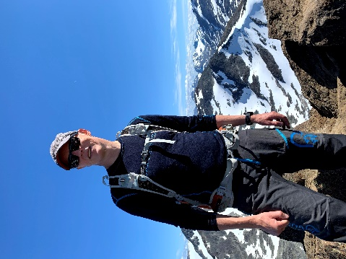
Harmonizing and linking conceptual models of geospatial information Technologies for information modelling in Geographic Information Systems (GIS), Intelligent Transport Systems (ITS) and Building Information Modelling (BIM)
Knut Jetlund
Norwegian University of Science and Technology
Norwegian Public Roads Administration
knut.jetlund@vegvesen.no
Twitter: @Jetgeo
LinkedIn: https://www.linkedin.com/in/knut-jetlund/
Photo: Knut Opeide, Statens vegvesen
1
27
Notes:
Thank you ... And thanks again to the committee for giving me this opportunity to defend my thesis
I have studied harmonization and linking of conceptual models of geospatial information. More specifically, technologies for information modelling in the three application domains of Geographic Information Systems (GIS), Intelligent Transport Systems (ITS) and Building Information Modelling (BIM).
The three application domains all operate in the geospatial environment we see in this picture, which we will come back to throughout the presentation.

Slide 2
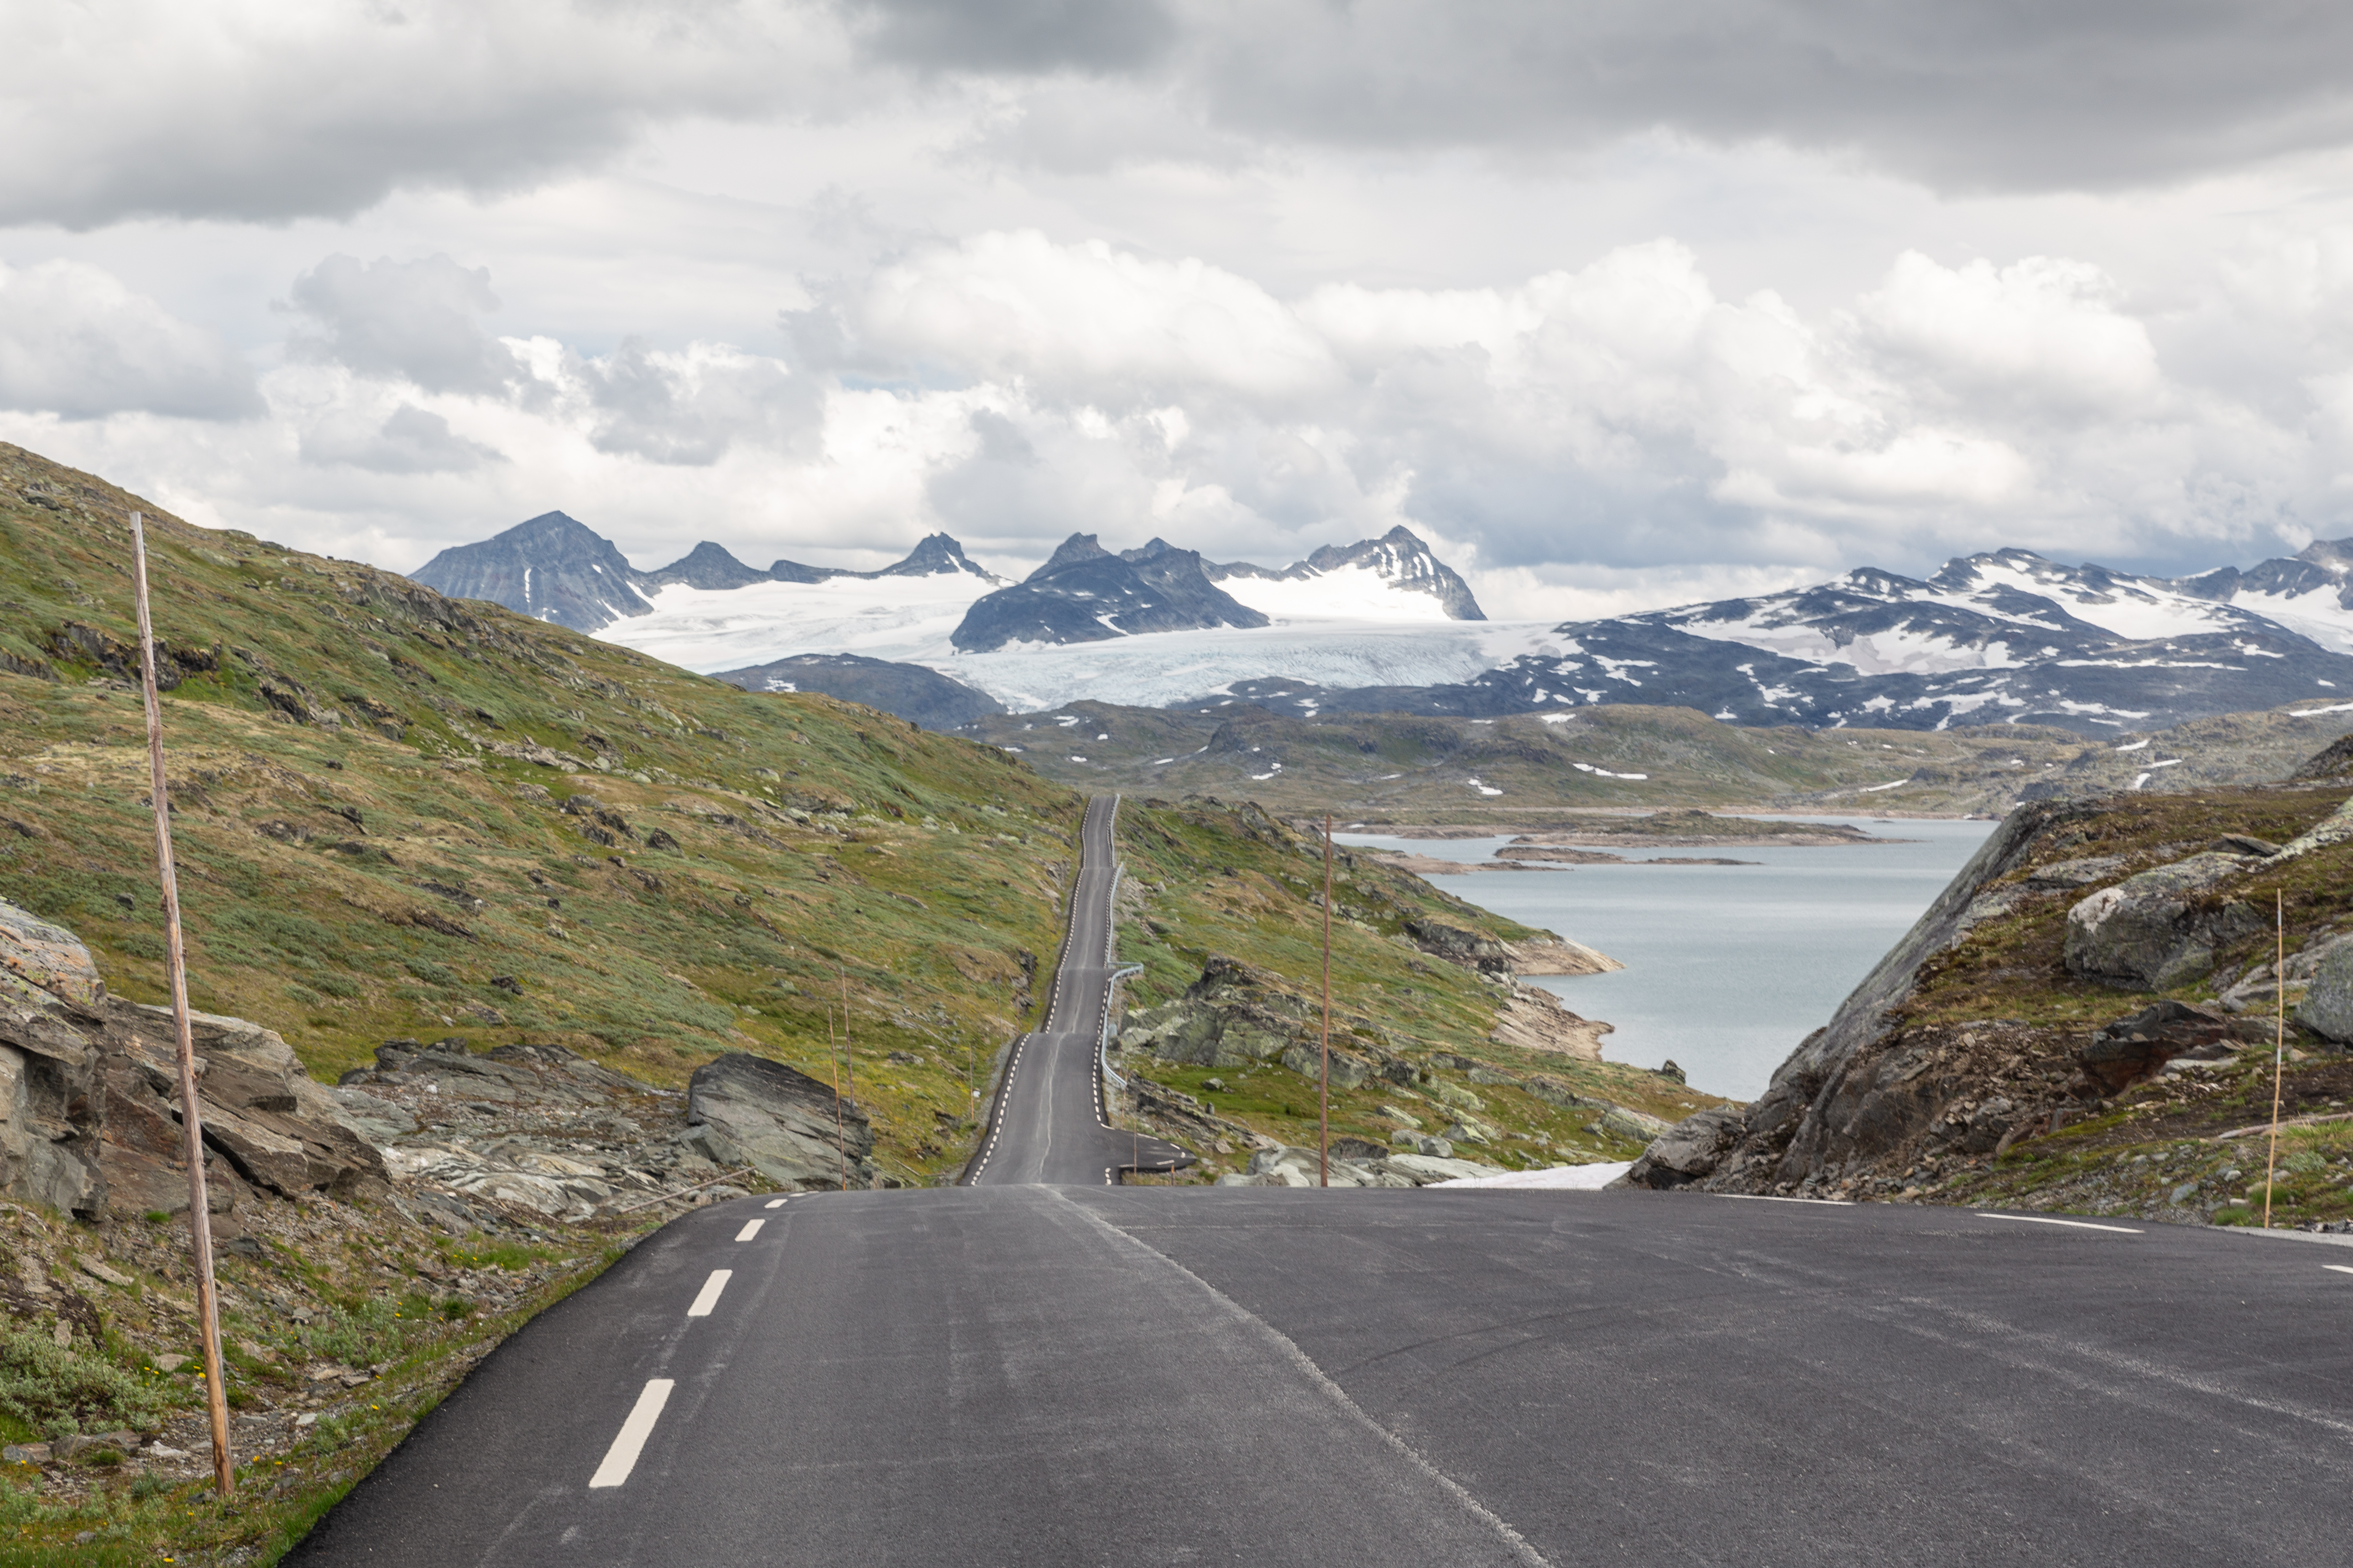
Agenda
Motivation
Research questions
Scientific approach
Theory
Results
Conclusions
Further work
Photo: Knut Opeide, Statens vegvesen
1
27
Notes:
In the presentation, I will first explain
the motivation, the research questions and the scientific approach.
Furthermore, a little bit of theory before we move to the results
and end up with conclusions and recommended further work.
So, let’s get started!

Slide 3
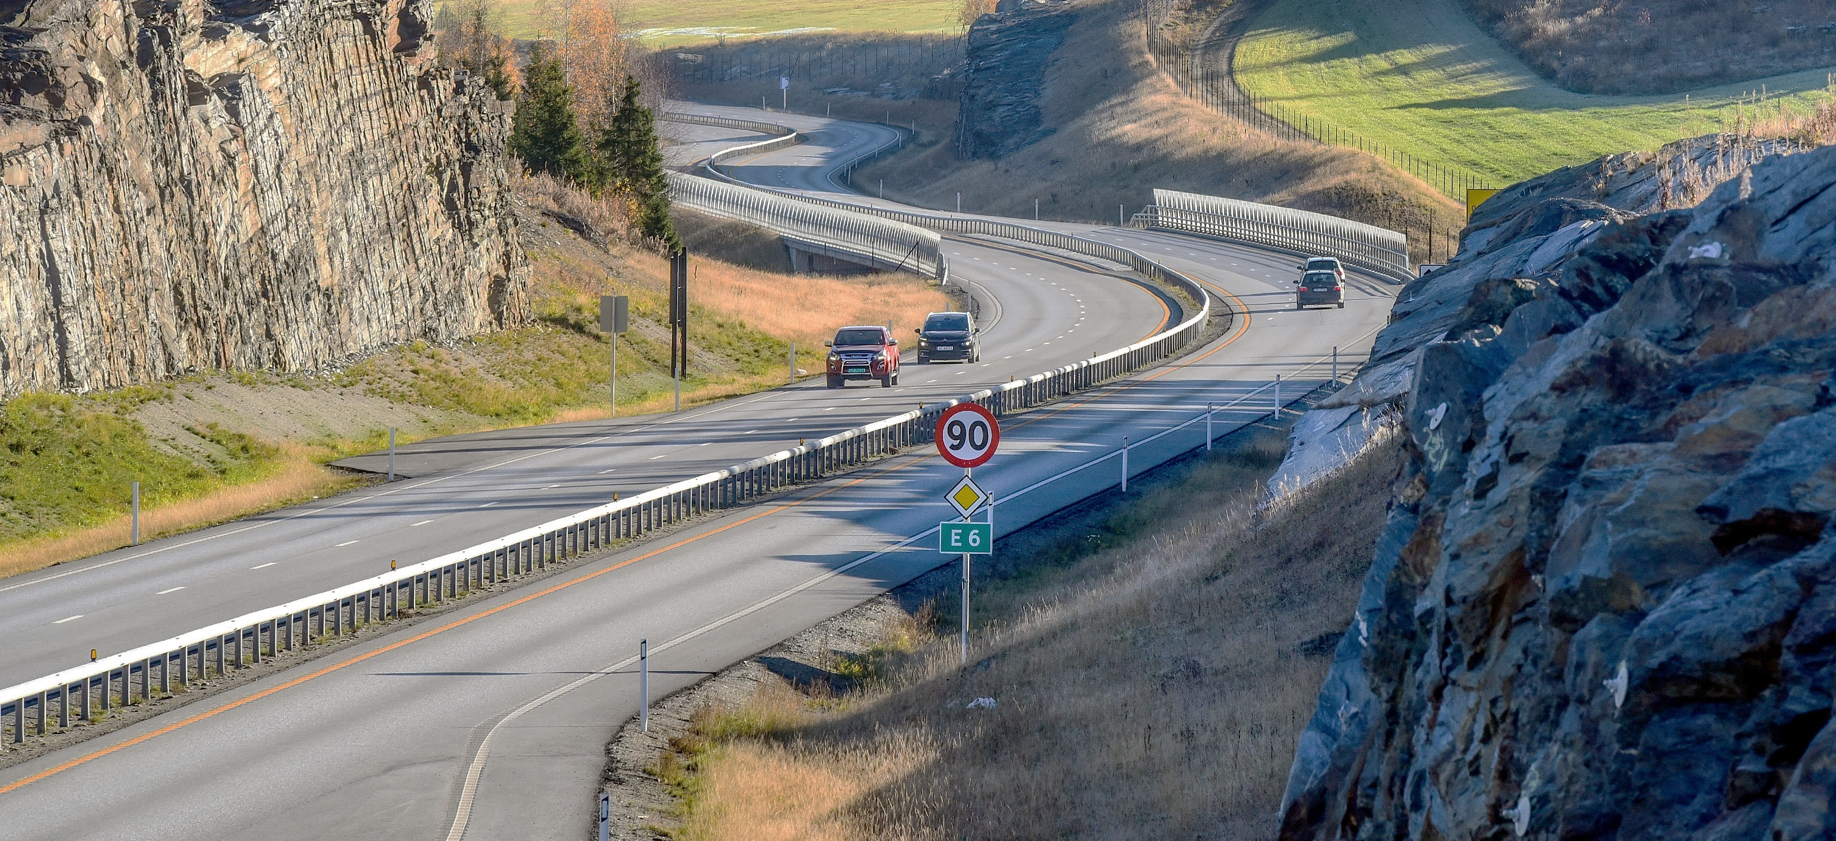
Three application domains, one real world
Photo: Knut Opeide, Statens vegvesen
2
27
Notes:
Constructions in the real world, such as features in the road infrastructure in this picture, relate to, influence and are influenced by, other features from the natural and built environment, through their location, shape and extent.
This geospatial context is vital for the representation of the natural and built environment in a digital environment as well.
During the lifecycle of the road, processes involve several application domains where the geospatial context is essential. Among these are the application domains of GIS, ITS and BIM. The three application domains have distinct, but related, roles, and handle the real world from different perspectives: Applications for GIS are mostly used for analyzing and presenting the existing natural and built environment, while applications for BIM are used for planning, developing, constructing and maintaining the built environment. Finally, applications and systems for ITS use the information about the built environment to plan and control transportation.
The three application domains work with the same physical geospatial environment, but due to the different roles, they have different views on the real world and its representation in a digital geospatial environment.

Slide 4
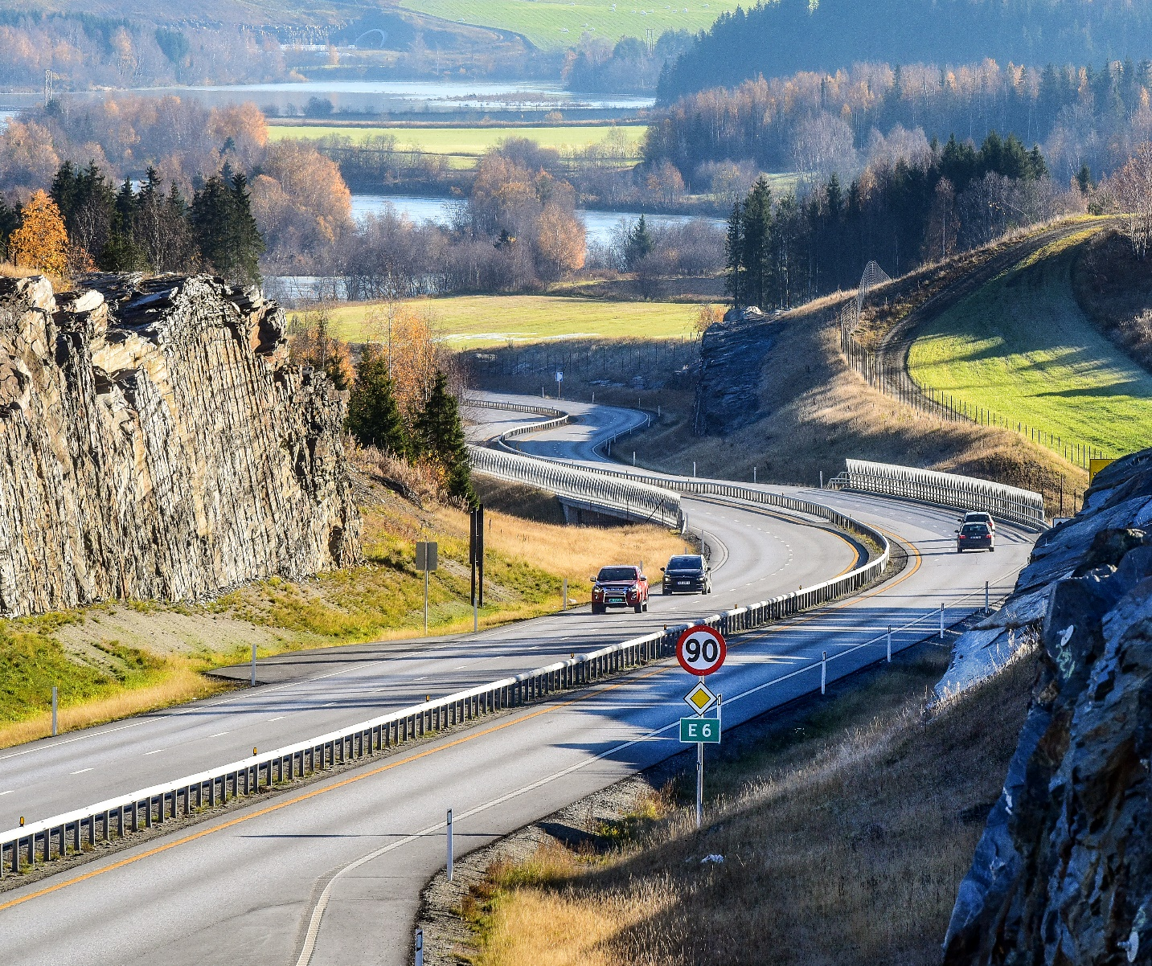
Reuse of information across domain borders
The challenge:
Reuse requires a common understanding of how the real world is described in information models
Modelling language
Terminology
Geometry and location referencing
Exchange formats
Photo: Knut Opeide, Statens vegvesen
3
27
Notes:
While the roles of GIS, ITS and BIM are distinct, and the application domains see the real world from different perspectives, the picture shows us that many of the real-world features and concepts they handle are the same. Therefore, reuse of information across application domain borders should be possible.
Before this road was built, there was mostly a natural environment, represented in GIS data sets. The new road was planned, developed and constructed with support from BIM processes. During the construction, the road cut into and changed the existing natural and built environment and became an integrated part of a new physical environment. Therefore, the GIS data sets need to be updated with the new built environment, as well as the changed natural environment. Also, ITS applications for route planning and navigation need an updated representation of the road environment, and of restrictions for navigation, such as speed limits and forbidden manoeuvres.
Let’s use the railings in this picture as an example: The digital representation of a guardrail along a new road will begin its life in the planning stage for the road, where the railing is created in a BIM application, as a feature that shall be constructed. The feature representation of the railing should later be reused in GIS datasets, for presentation on maps, and, for example, for calculating noise pollution. Furthermore, the same railing is needed in High Definition maps for ITS as an obstacle that vehicles need to be aware of. The different domains need specific information about the feature, but they are all referring to the same real-world phenomenon.
The challenge we face in the exchange and reuse of information is that the different application domains have developed information models with their specific interpretation of the real world. In order to understand information across domain borders, we need a common understanding of how the real world is described in information models. This concerns the modelling languages that are used, the terminology, how geometry and location references are described, and the exchange formats that are used.

Slide 5
How can we achieve a common understanding?
Research question:
“How can approaches and technologies for information modelling be applied for harmonization and linking of conceptual models of geospatial information from the three application domains of GIS, ITS and BIM?”
4
27
Notes:
So, how can we achieve this common understanding?
This was the main research question for the thesis, formulated as: «How can approaches and technologies for information modelling be applied for harmonization and linking of conceptual models of geospatial information from the three application domains of GIS, ITS and BIM?”
As we have seen from the previous slides, the three application domains have different views on the real world. And, most likely, they will need to be different, as they use the digital representations in different ways and for different purposes. We need to acknowledge that a full harmonization of information models may not be appropriate. Therefore, the thesis studies harmonization, and linking, of heterogeneous models, as illustrated in the figure. We strive for a harmonization but acknowledge the need for linking in addition.

Slide 6
5
27
Notes:
The main research question was supported by five sub research questions, which in sum were intended to cover information modelling in the three application domains, the roles they have in the digital geospatial environment, and the relations between them.
The questions were addressed through five published articles and a conference proceeding, as well as through contributions to other relevant work in international standardization.
As shown in the figure, there were relations between the sub research questions: The first question established the fundament for addressing the four others, and question 4 depended on input from question 2, 3 and 5.

Slide 7
Scientific approach
IFC schemas in ISO/TC 211 UML
A generic information model for exchange GIS to ITS
A structure of UML profiles for GIS, ITS and BIM
Modelling rules and rules for conversion from UML to OWL
6
27
Notes:
The first sub research question was studied in a literature review, while the four others were studied with prototype experiments.
One prototype was developed and tested for each of the four sub research questions, as illustrated in this figure: the relation between GIS and ITS, the relation between GIS and BIM, conversion from UML to OWL, and, finally, a harmonized modelling approach with a structure of UML profiles.

Slide 8
DIKW - Data, Information, Knowledge and Wisdom
Information model:
“… a formal description of types of ideas, facts and processes which together form a model of a portion of interest of the real world and which provides an explicit set of interpretation rules.” (Schenck and Wilson, 1994).
“… a representation of concepts, relationships, constraints, rules, and operations to specify data semantics for a chosen domain of discourse” (Zhao et al., 2011)
The DIKW Hierarchy. Adapted from (Rowley, 2007).
7
27
Notes:
Before we move into the research results, let’s walk through some theoretical background, especially on the terms data and information.
The hierarchy of Data, Information, Knowledge and Wisdom has been described as a pyramid, where data is at the lower level, followed by information and knowledge, and wisdom at the pinnacle. Each level of the hierarchy, starting from the top, relies on the level below: wisdom is gained from knowledge; knowledge is gained from information; information is gained from data.
Data are simple symbols. For example, the numbers «90» or «2».
Information is data put into context, where it has a meaning. For example, the speed limit 90 km/h or outdoors temperature 2 degrees Celcius.
Knowledge is gained by combining information. For example, a vehicle can know that it is allowed to drive at 90 km/h according to the speed limit, but also that it should reduce the speed due to possible challenging conditions because the outdoors temperature is 2 degrees.
The final level, wisdom, has been described as a purely human state. With wisdom, we are able to plan for the future and apply knowledge to new situations.
Information models are the interpretation rules needed to extract information from data. The thesis is based on an understanding of the term information models from Schenk and Wilson in 1994: “… a formal description of types of ideas, facts and processes which together form a model of a portion of interest of the real world and which provides an explicit set of interpretation rules.”
A similar definition was described by Zhao et al in 2011: “… a representation of concepts, relationships, constraints, rules, and operations to specify data semantics for a chosen domain of discourse”.

Slide 9
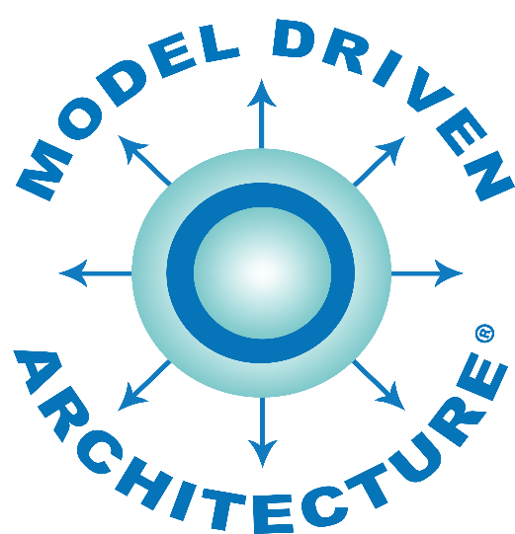
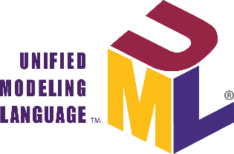

Information modelling
From the real world to conceptual models. Adapted from ISO 19101-1:2014
8
27
Notes:
The two definitions in the previous slide mentioned “a portion of interest” and “a domain of discourse”. These terms are an important fundament for the process of information modelling. Obviously, one single model cannot describe every concept from the real world in every context, we need to define some portion that we are interested in, such as a road network, buildings or utilities.
This figure, which is adapted from ISO 19101, describes the process of information modelling, where the first step is to select a portion of interest from the fuzzy cloud we know as the real world and perceive it in a context. The portion of interest is often referred to as a universe of discourse.
The universe of discourse will be defined in a conceptual model, but in order to create a formal description, we need some kind of formalism. For this, we need a conceptual schema language, which can describe the model in a conceptual schema. Two such conceptual schema languages are the Unified Modelling Language, UML, and the Web Ontology Language, OWL. The Model-Driven Architecture approach (MDA) is a much-used approach for the development and implementation of information models, where models are defined at different levels of abstraction.

Slide 10
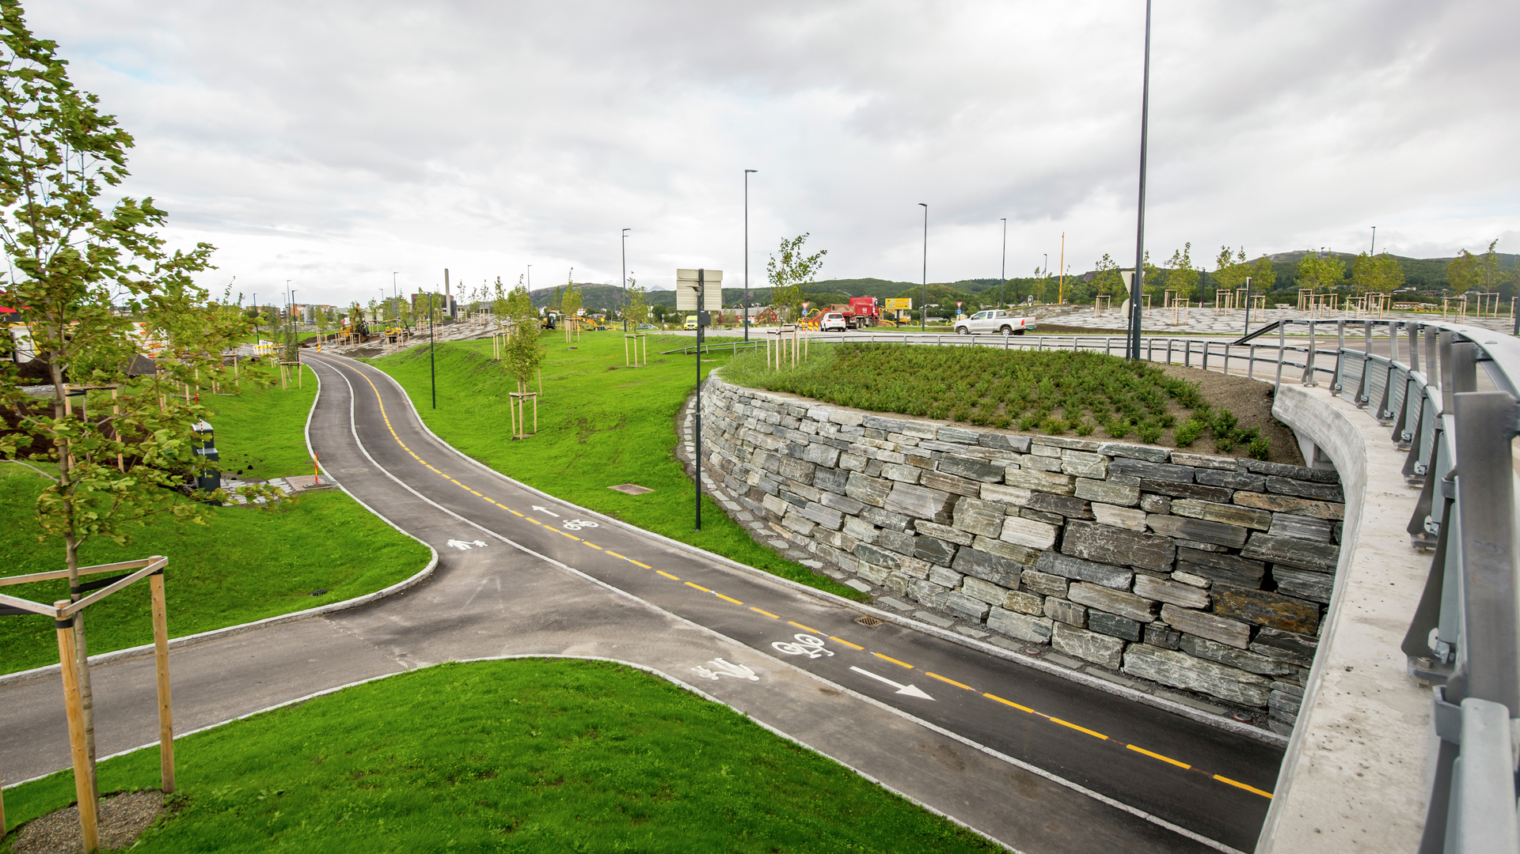
Results
Photo: Torbjørn Braset, Statens vegvesen
9
27
Notes:
So, with the theoretical background in place, let’s look at the results from the research.

Slide 11
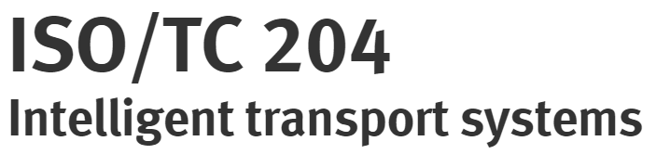
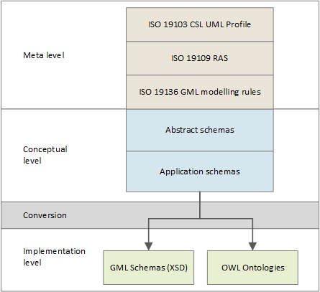

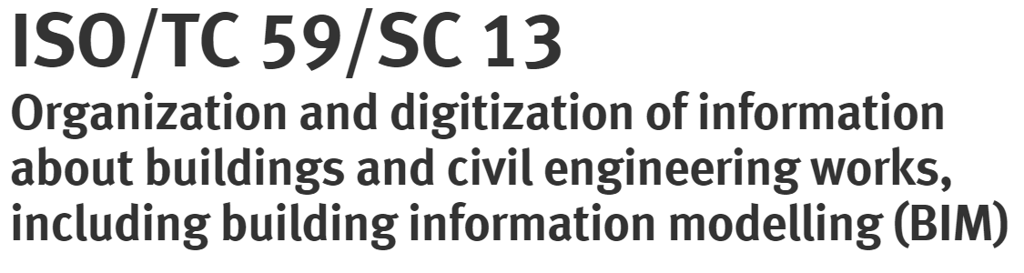


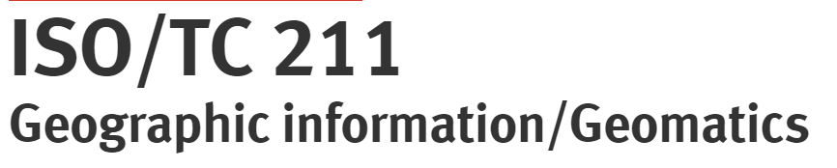
SRQ1: State of the art
“What approaches and technologies have been used for modelling geospatial information in GIS, ITS and BIM?”
All three application domains:
Conceptual schemas in UML
Some degree of MDA
UML and MDA for GIS the most complete approach
But with defeciencies
10
27
Notes:
The state-of-the-art analysis showed that standards and specifications from all three application domains describe models of geospatial information, with various approaches and technologies.
A number of specifications exist in the ITS domain, but the ISO/TC 204 standard GDF has been identified as the primary official model for geospatial information. While the Navigation Data Standard is an essential industry standard. Other essential ITS standards are TPEG2 and DATEX II for dynamic information.
In the BIM domain, the core concepts for geospatial information are defined in the IFC specification, developed by buildingSMART and standardized by ISO/TC 59.
In the GIS domain, ISO/TC 211 and OGC have standardized the basic concepts for the use of MDA and UML in a range of standards, and organizations all over the world have developed domain models of geospatial information based on those standards.
A common denominator for all application domains was the use of UML as the conceptual schema language, and modelling approaches with some degree of MDA.
The information modelling approach in GIS as standardized by ISO/TC 211 was identified as the most structured and complete approach for modelling geospatial information.
The defined UML profiles, the MDA approach with specified levels of abstraction, modelling and conversion rules, and the modular structure, are advantages compared to approaches in the two other application domains. However, deficiencies were found in the GIS approach as well, by this research as well as others.
Therefore, the further research focused on the development of an improvement of the GIS approach, and the development of domain models according to the improved approach.

Slide 12
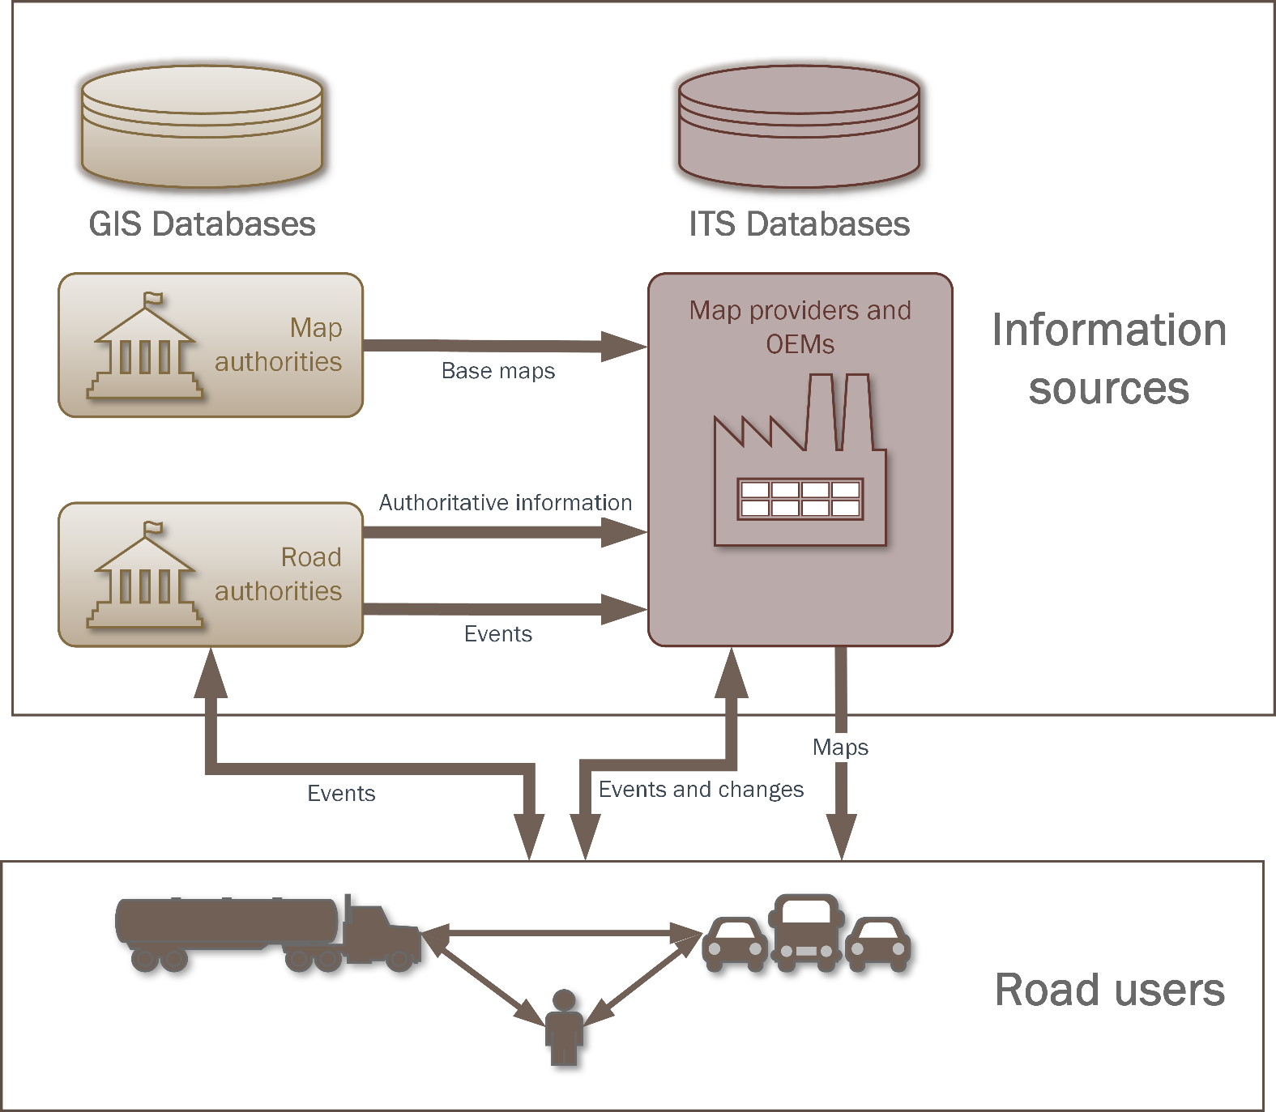
SRQ2: Information exchange from GIS to ITS
“How can models for exchange of geospatial information from road and mapping authorities to geospatial databases for ITS be improved?”
Requirement
Req 1: ISO/TC 211 MDA
Req 2: GIS exchange format
Req 3: Feature catalogue
Req 4: Feature catalogue exchange model
Req 5: Network model
Req 6: Generic feature exchange model
11
27
Notes:
The second sub research question concerned the information exchange from GIS to ITS, as illustrated in this figure from Article 1.
Modern vehicles contain a range of sensors and create local geospatial knowledge from them. However, this knowledge is not sufficient for route planning or for local navigation under challenging conditions such as fog or snow-covered roads. It must be combined with geospatial information from pre-processed databases. Road authorities are the authoritative source for the information needed for legal and safe navigation in the road network, and maintain the information in applications and databases from the GIS domain. Sub research question 2 studied information models for providing this information to map providers in the ITS domain, as illustrated by the horizontal arrows in the figure.
We set up six requirements for such information models, as listed in this table, and evaluated ten existing standards and specifications. The requirements were specified for studying two main topics: Usability in GIS, and flexibility for changes in feature catalogues.
The analysis showed that none of the studied solutions met all requirement, but four of the ten were promising candidates as a basis for an improved solution.

Slide 13
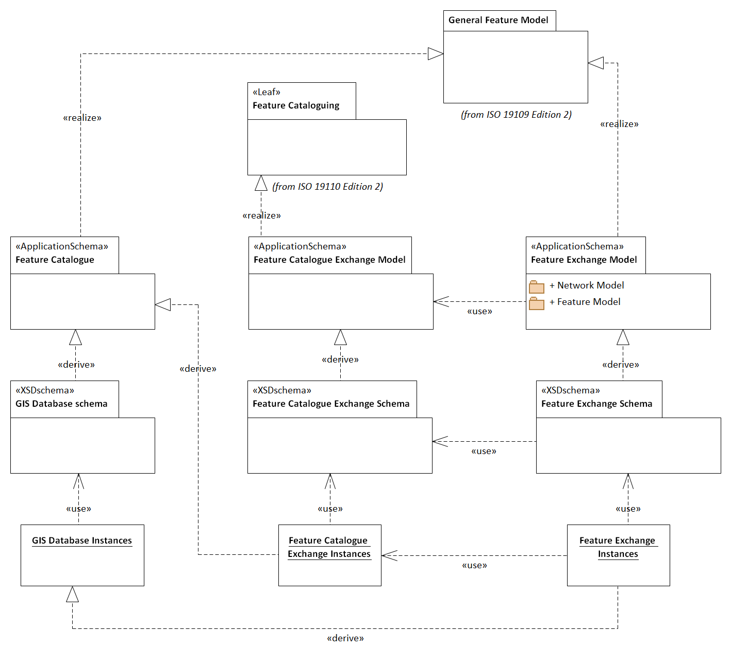
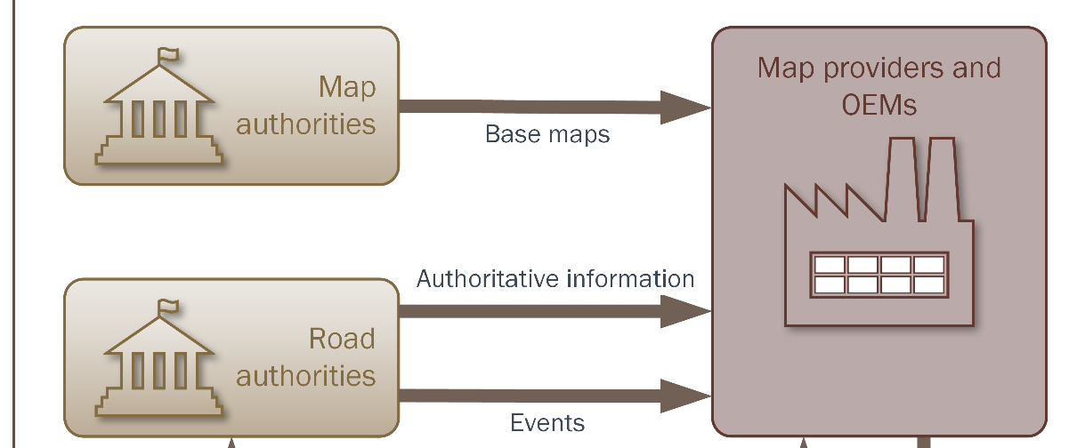
Prototype experiment
ISO/TC 211 MDA
GIS exchange format
Feature catalogue
Feature catalogue exchange model
Generic feature exchange model
Network model
1
2
3
4
5
6
7
8
9
10
11
12
27
Notes:
As none of the studied solutions met all requirements, a prototype of an improved solution was developed and tested. The goal was to support the information exchange illustrated by the figure, by fulfilling all the specified requirements.
The prototype was based on the four promising candidates from the evaluation: INSPIRE, TN-ITS, GDF and OpenTNF, and consists of three interwoven models, with implementation schemas for GML: A generic feature exchange model, a feature catalogue exchange model, and feature catalogue model. The feature catalogue model could contain any application schema conformant with the ISO/TC 211 standard ISO 19109.

Slide 14
Validation: The GIS to ITS prototype
Requirement | Prototype approach
Req 1: ISO/TC 211 MDA | Yes
Req 2: GIS exchange format | Yes – GML in the prototype
Req 3: Feature catalogue | Any feature catalogue described as an ISO 19109 application schema. Tested with INSPIRE and GDF in a case study
Req 4: Feature catalogue exchange model | Yes – Implemented in GML
Req 5: Network model | Yes
Req 6: Generic feature exchange model | Yes – Implemented in GML
Future improvements:
More complex road network models (GDF, NDS)
Belts and Traffic spaces (GDF 5.2 and CityGML 3.0)
1
2
3
4
5
6
7
8
9
10
11
12
13
27
Notes:
The prototype was tested in a case study with the feature catalogues from INSPIRE and GDF. The INSPIRE Transport Networks model could be used directly in the prototype, while only minor modifications were needed for the GDF information model to make it compliant with ISO 19109.
Furthermore, a validation showed that the prototype met all six requirements, as illustrated in this table.
A comparison against existing solutions indicated that the prototype covered and improved concepts defined in standards such as GDF and TN-ITS. However, several existing solutions, such as GDF and the Navigation Data Standard, have more complex network models with levels of topology and information at lane-level. Also, even more complex area and volume representations are important for automated driving and are under development in GDF and CityGML. A future solution for information exchange will need to handle these complex representations, and the authoritative databases will need more complex models for this purpose as well.

Slide 15
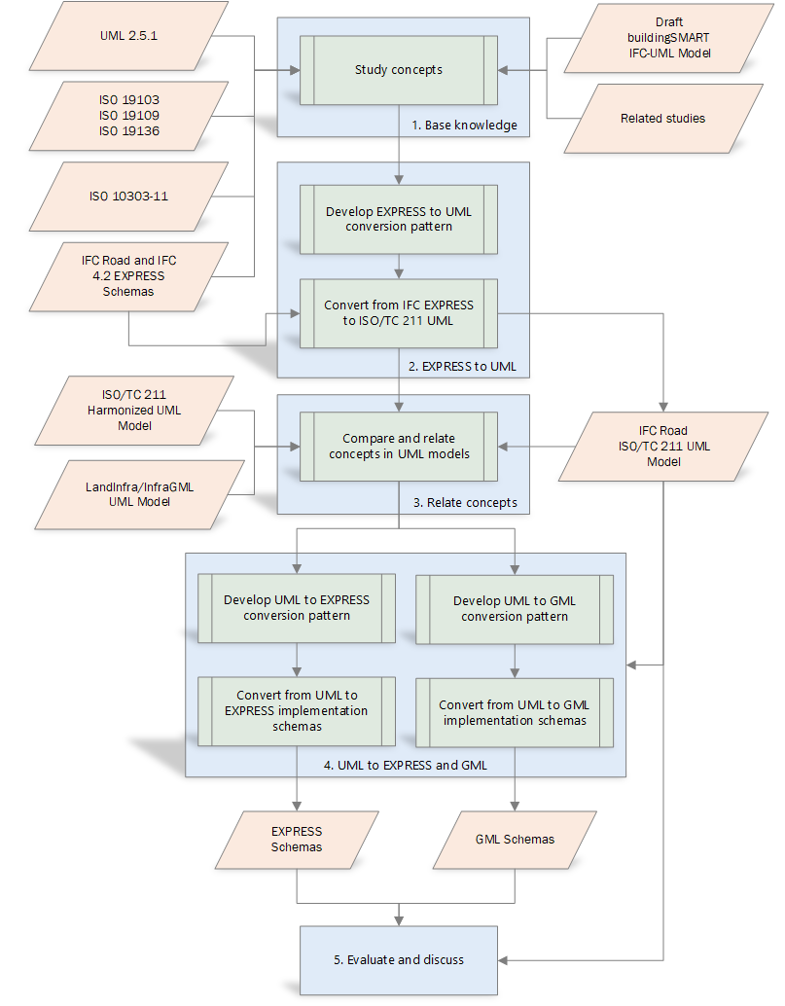
SRQ3: Integration of models for GIS and BIM
Syntactic
Semantic
“How can information models and semantics for implementation technologies for BIM be integrated and linked with GIS standards?”
Implementation
1
2
3
4
5
6
7
8
9
10
11
12
13
14
27
Notes:
The third research question concerned the integration between GIS and BIM, by asking how information models and implementation technologies for BIM could be integrated and linked with GIS standards.
A prototype experiment was set up for conversion from IFC EXPRESS schemas into ISO/TC 211 compliant UML models.
The syntactic interoperability was addressed by a conversion pattern from EXPRESS, as used in IFC, to UML, as used in ISO/TC 211 standards.
Furthermore, semantic interoperability was addressed by linking and mapping core concepts from IFC to concepts defined in ISO/TC 211 standards.
Finally, the prototype UML model was tested for implementation in EXPRESS, as a kind of re-engineering, and in GML through ISO/TC 211 rules for conversion.

Slide 16
Validation:
The BIM/GIS prototype
Syntactic interoperability
Most EXPRESS concepts maintained
Semantic interoperability
Not all concepts could be linked
Common concept preferred
Implementation
Extra semantics for EXPRESS
Mapping of geometry concepts vital for GML
1
2
3
4
5
6
7
8
9
10
11
12
13
14
15
27
Notes:
Validation of the prototype showed that the conversion pattern maintained most of the EXPRESS concepts from IFC, while a few concepts needed a more complex and controlled conversion.
Furthermore, the semantic interoperability was improved by linking data types from IFC to equivalent types from ISO/TC 211 standards. However, not all data types could be linked. Better semantic interoperability could be reached if models reused basic datatypes from more general models. Especially, better semantic interoperability for geometry and location referencing datatypes would be possible if original datatypes were defined in one of the models and reused in both.
For the implementation, the results showed that EXPRESS implementation was possible through the reverse conversion pattern. The implementation in GML, based on the standardized rules for conversion, was also possible, due to the established links between core concepts. However, the incomplete harmonization, and linking, of data types for geometries and location referencing proved to be a challenge for implementation in GML and could have been improved with the use of common concepts.

Slide 17

SRQ5: Ontologies for linking and mapping
“How can UML models of geospatial information be implemented as OWL Ontologies, for linking and mapping by applying Semantic Web technologies?”
1
2
3
4
5
6
7
8
9
10
11
12
13
14
15
16
27
Notes:
I will now move to sub research question five, and come back to number four later.
Sub research question five concerned the relationship between UML models and OWL ontologies, focusing on the use of OWL Ontologies for linking and mapping of heterogeneous models of geospatial information. As we remember from the illustration of the main research question, we acknowledged that the models could not be completely harmonized, and that additional linking and mapping would be necessary. Semantic web technologies such as OWL and SPARQL have been considered a valuable approach for this purpose.
In order to enable UML models for use in the Semantic Web, the UML models must be converted to OWL ontologies, and this conversion was the topic for the sub research question.

Slide 18
Fundamental differences
Closed World Assumption (CWA)
The information model is complete in the given context
Additional or deviating information is invalid
Open World Assumption (OWA)
The information model presents only what is currently known in the given context
Additional information extends the model
Structure of information
Meaning of concepts
1
2
3
4
5
6
7
8
9
10
11
12
13
14
15
16
17
27
Notes:
The studies found that conversions from UML to OWL are possible, and have been described in ISO/TC 211 standards, OGC Testbeds, and in related research. However, some challenges were identified and were mainly related to fundamental differences between how UML and OWL describe the real world.
First, UML focuses on the structure of information, while OWL focuses on the meaning of concepts. In UML, we define, for example, that a feature is a Railing, and has specific properties, while another feature is a Fence and has its specific properties as well. While in OWL, we define that a thing that has some defined properties is a Railing, but it can also be a Fence at the same time. Which is more like we see it in the real world: The same feature may be a railing and a fence. Classification depends on the context.
Besides, properties in OWL so-called first-class individuals who exist on their own, while UML attributes and associations are uniquely owned by the individual class.
Furthermore, UML models are defined in a closed world assumption, where we assume that the model is complete in the given context. Information that does not fit the model will be invalid. Contrary, OWL is based on an open-world assumption, where anyone can say anything about any topic. The model represents only what is currently known in the given context and may be extended with additional information.
---
Due to these differences, UML models are more restricted, and representations of UML restrictions is a challenge for the conversion from UML to OWL.

Slide 19
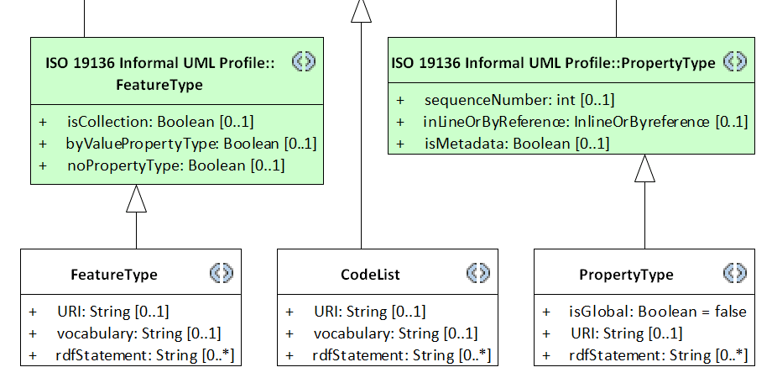
Prototype experiment and validation
Prototype experiment:
Extended UML profile for OWL Encoding
Global or shared properties
Links to external concepts
Implemented in the joint approach (SRQ4)
Adapted rules for modelling and conversion
Prototype validation:
Conversions for the studied issues were improved by adding semantics and modelling as suggested
1
2
3
4
5
6
7
8
9
10
11
12
13
14
15
16
17
18
27
Notes:
We set up a prototype experiment to test whether the conversions from UML to OWL could be improved. The prototype was set up as an extended UML profile, supported by adapted rules for conversion from UML to OWL. Especially, two conversion issues were addressed by the prototype: Properties that are identical for several classes in UML and can be globalized in OWL, and links for reusing external concepts.
The validation of the prototype showed that conversions for the two specific issues could be improved by adding more semantics to the UML model, based on the extended UML profile, and by applying the adapted rules for modelling and conversion.

Slide 20
Level of information flow
Conversions of restrictions from the CWA to the OWA must be configured according to the selected level of information flow:
Ontologies for use only in the Semantic Web
Unidirectional information exchange to the Semantic Web
Bidirectional information exchange
1
2
3
4
5
6
7
8
9
10
11
12
13
14
15
16
17
18
19
27
Notes:
The most essential observation from the sub research question was that the need for maintaining restrictions from UML in OWL will depend on the intended level of information flow for the resulting ontologies. We defined three levels of information flow:
Ontologies for use only in the Semantic Web, in which case restrictions and the original structure from the UML models can be disbanded.
Unidirectional information exchange from UML based models to the Semantic Web. As for the first level of information flow, few restrictions from the UML model are needed in the ontologies, as they will primarily be used for describing the information.
Bidirectional information exchange. For this purpose, the OWL ontologies and the original UML model should be as identical as possible. The information must be valid according to the UML models to make sure it can be imported into repositories defined by the UML models. Therefore, conversions need to maintain restrictions and the original structure as far as possible.
Model-driven conversions from UML to OWL need to consider the different levels of information flow and apply conversions appropriate for the selected level. Therefore, conversion rules, and software implementing the rules, need to be configurable.

Slide 21
SRQ4: A joint modelling approach
“How can information models and semantics for implementation technologies for GIS, ITS and BIM be integrated into a joint modelling approach?”
1
2
3
4
5
6
7
8
9
10
11
12
13
14
15
16
17
18
19
20
27
Notes:
Finally, we have come to SRQ4, which concerned a joint modelling approach for the three application domains.
As we can see from this illustration of the five SRQs, results from the four other SRQs served as input to SRQ4. That’s the reason why I presented question five before number four.
The results from SRQ1 identified the GIS approach based on ISO/TC 211 standards as the most complete approach for information modelling.
The results from SRQ2 showed that information models for the exchange of information from GIS to ITS, including the GDF feature catalogue, could be based on the GIS MDA approach.
Likewise, the results from SRQ3 showed that the IFC specification for BIM could be transformed into the GIS MDA approach.
And finally, the results from SRQ5 showed that conversions from UML to OWL could be improved by adding more semantics and rules to the GIS approach.

Slide 22
Prototype experiment:
A structure of UML Profiles for GIS, ITS and BIM
1
2
3
4
5
6
7
8
9
10
11
12
13
14
15
16
17
18
19
20
21
27
Notes:
The findings on the use of UML and MDA from the other SRQs served as input to a prototype experiment with a structure of UML profiles for information modelling in the three application domains. The structure was based on a framework originally developed by Kutzner in 2016, and adapted to fit the findings and the scope in this thesis.
The structure contains four levels of profiles, connected through package merge relations:
The base profile and the community conceptual profiles define general and community-specific concepts for Platform-Independent Models.
The general and community encoding profiles defines general and community-specific semantics for Platform-Specific Models.

Slide 23
Prototype validation
The structure could be implemented in UML sofware
Existing and prototype models could be adapted
Recommended actions:
Revise UML profiles: ISO 19103 and ISO 19109
Define formal UML profiles: ISO 19136 and ISO 19150-2
Define encoding profiles: EXPRESS
Define conceptual and encoding profiles: TPEG2
Define mapping: DATEX II
1
2
3
4
5
6
7
8
9
10
11
12
13
14
15
16
17
18
19
20
22
22
23
27
Notes:
Validation of the prototype showed that it could be implemented in the UML software Enterprise Architect, which is used for information modelling in all three domains.
Furthermore, the validation and the results from other SRQs showed that existing domain models for ITS and BIM could be adapted into the structure of profiles.
We described several recommended actions for implementation of the structure:
Revise and improve existing UML profiles for ISO 19103 and ISO 19109, and define formal encoding profiles for GML and OWL, based on existing and improved conversion rules.
Encoding profiles for additional implementation technologies should be defined. Especially, semantics for EXPRESS encoding was specified under SRQ3.
Conceptual and encoding profiles should be defined for TPEG2, based on the defined modelling rules
While for DATEX II, one will need a mapping between the existing DATEX II UML Profile and the suggested structure. The existing profile should still be used, but can be mapped into the joint approach, for closer integration with other information models.

Slide 24
Conclusions - main contribution
A joint approach for information modelling
Prototypes for profiles and models within the harmonized approach
1
2
3
4
5
6
7
8
9
10
11
12
13
14
15
16
17
18
19
20
22
23
23
24
27
Notes:
The most important outcome of the research presented in this thesis was the development and testing of the joint, harmonized approach for modelling geospatial information in the three application domains, founded on MDA and a structure of UML profiles.
Furthermore, prototypes of the core information models IFC for BIM, and GDF for ITS, showed that models for BIM and ITS could be transformed into a joint approach.
By describing all prototype models and metamodels in the same conceptual schema language, based on a joint modelling approach and with common core concepts, the research showed that improved syntactic and semantic interoperability between GIS, ITS and BIM could be achieved.

Slide 25
Conclusions
Full harmonization not appropriate
Apply LinkSets for mapping
Apply the joint modelling approach for all three domains
Use common core concepts
Data types from non-domain-specific models
Common concepts for geometry and location referencing
Photo: Knut Opeide, Statens vegvesen
1
2
3
4
5
6
7
8
9
10
11
12
13
14
15
16
17
18
19
20
22
23
24
24
25
27
Notes:
The research indicated that a full harmonization would not be the best solution for optimized use in each application domain. The three application domains have different roles in the digital geospatial environment and need to describe features from the real world in different contexts, with different representations.
Therefore, further improvements of the semantic interoperability must be achieved by applying Linksets based on Semantic Web technologies for linking and mapping of heterogeneous information models. For this purpose, the research showed that conversions from UML to OWL could be improved, but must be configured according to the level of information flow.
Even though the models cannot be wholly harmonized, they should be as harmonized as possible. Any transformation leads to a loss of information, and models that are based on the same modelling approach and use the same core concepts are more similar, and fewer transformations are needed.
Therefore, the joint modelling approach should be applied, and common, core concepts should be used as far as possible. In particular, general concepts for core datatypes should be used in all domains, and common concepts for geometry and location referencing should be established and used.

Slide 26
Similar representations
Tobler’s first law of geography (Tobler, 1970):
“everything is related to everything else, but near things are more related than distant things”.
Modernized to a digital world with multiple representations of the same physical ”thing”:
“every digital representation of a thing can be linked to any other digital representation of the same thing, but links between similar representations are more precise than links between dissimilar representations”.
1
2
3
4
5
6
7
8
9
10
11
12
13
14
15
16
17
18
19
20
22
23
24
25
25
26
27
Notes:
51 years ago, the geographer Waldo R Tobler defined his first law of geography as
“everything is related to everything else, but near things are more related than distant things”.
Following the conclusions from the previous slide, Tobler’s first law can be modernized into a digital world with multiple representations of real-world things, saying that
“every digital representation of a thing can be linked to any other digital representation of the same thing, but links between similar representations are more precise than links between dissimilar representations”.
In other words; we should strive towards digital representations that are as similar as possible.

Slide 27

Limitations and further research
Limitation:
Studied at a conceptual level, need experiences from implementations
Further research:
Common core concepts
Use of OWL Ontologies
Higher levels of interoperability
Other application domains
Photo: Knut Opeide, Statens vegvesen
1
2
3
4
5
6
7
8
9
10
11
12
13
14
15
16
17
18
19
20
22
23
24
25
26
26
27
Notes:
Of course, there is always more work to do.
The most essential limitation was that the research in the thesis was conducted at a core conceptual level only. It should be supplemented with experiences from real implementations in the three application domains.
Besides, several opportunities for further research were revealed:
First, more studies should be performed on core concepts for use in all three domains. Especially, a common model for geometry and location referencing would be a major improvement.
Furthermore, the research indicated a need for more studies on how geospatial information can be made available and used in the Semantic Web.
Finally, this research has focused on the syntactic and semantic interoperability, while other levels of conceptual interoperability are needed for applications and organizations to achieve actual interoperability of real implementations. And, of course, GIS, ITS and BIM are not the only application domains where geospatial information is vital. Other domains, such as Life-Cycle Analysis and Smart Cities should also be included in studies of a complete digital geospatial environment.

Slide 28
Thanks for listening!
Knut Jetlund
Norwegian University of Science and Technology
Norwegian Public Roads Administration
knut.jetlund@vegvesen.no
Twitter: @Jetgeo
LinkedIn: https://www.linkedin.com/in/knut-jetlund/
Photo: Knut Opeide, Statens vegvesen
1
2
3
4
5
6
7
8
9
10
11
12
13
14
15
16
17
18
19
20
22
23
24
25
26
26
27
Notes:
Ok, thank you for listening,
I would like to express a special thanks to my supervisors Erling, Lizhen and Rune. And, of course, to my wife and the rest of my family for their patience and understanding. Thank you all!

